Slide 1






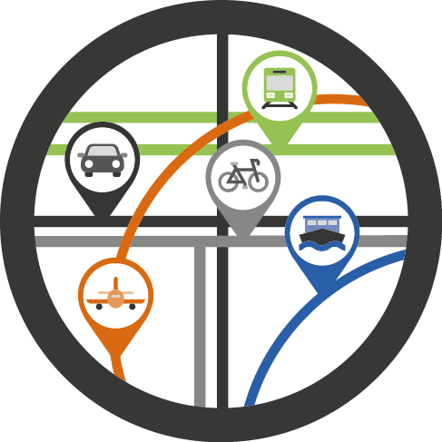







Fundamental Data Themes
Global Geodetic Reference Frame
Geographical Names
Addresses
Functional Areas
Buildings and Settlements
Land Parcels /Properties
Transport Networks
Elevation and Depth
Population Distribution
Land Cover and Use
Geology and Soils
Physical Infrastructure/
Service Points
Water
Imagery

Slide 2














Fundamental Data Themes
Global Geodetic Reference Frame
Geographical Names
Addresses
Functional Areas
Buildings and Settlements
Land Parcels /Properties
Transport Networks
Elevation and Depth
Population Distribution
Land Cover and Use
Geology and Soils
Physical Infrastructure/
Service Points
Water
Imagery

Slide 3
Fundamental Data Themes
Global Geodetic Reference Frame
Geographical Names
Addresses
Functional Areas
Buildings and Settlements
Land Parcels /Properties
Transport Networks
Elevation and Depth
Population Distribution
Land Cover and Use
Geology and Soils
Physical Infrastructure/
Service Points
Water
Imagery

